Slide 1

Analysing Housing Prices in Metropolitan Areas of India
Tejeshini.S

Slide 2
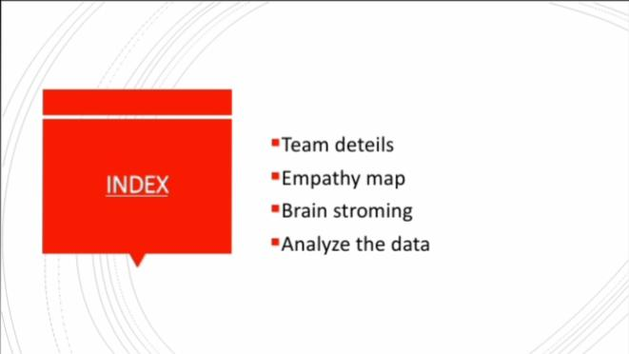

Slide 3
TEAM DETAILS
TEAM LEADER:
S.TEJESHINI
TEAM MEMBERS:
S.VIDHYA SRI
N.THRISHA
P.VIJAYALAKSHMI
K.BHAGAVATHI

Slide 4
EMPATHY MAP
An empathy map is a tool used in Analysing housing price in Meteropolitan areas of India
It has 4 quadrants

Slide 5
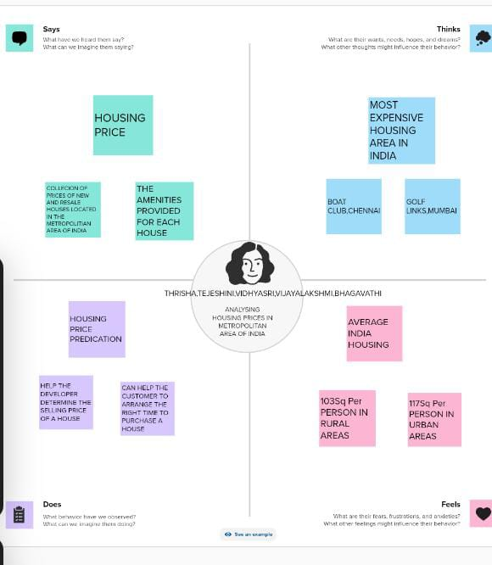
1. HOUSING PRICE
2.MOST EXPENSIVE AREAS IN INDIA
3.HOUSING PRICE PREDICTION
4.AVERAGE INDIA HOUSING

Slide 6
BRAIN STORMING
Brain storming is a group of creativity technique by which efforts are made to find a conclusion for a specific problem by gathering a list of ideas spontaneously contributed by its members

Slide 7
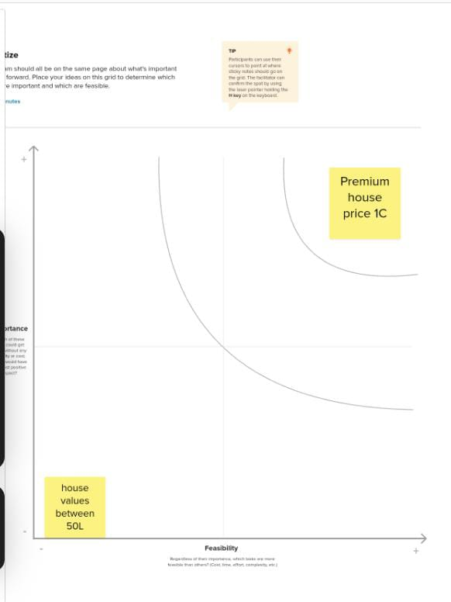
OUR GROUP WORK

Slide 8
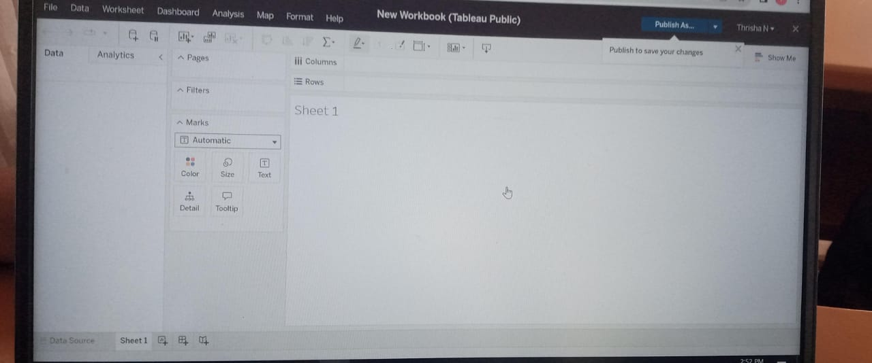
ANALYSIS OF DATA

Slide 9
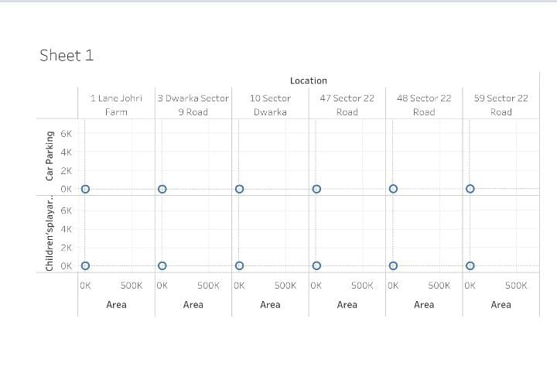
HOUSE PRICE IN BAGALORE

Slide 10
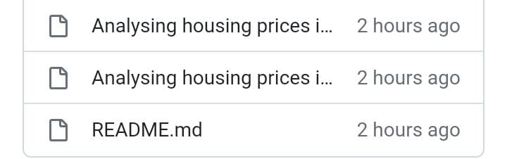

Slide 11
CONCLUSION
House price in the 15 Meteropolitan cities do not converge to the LOOP.

